Slide 1
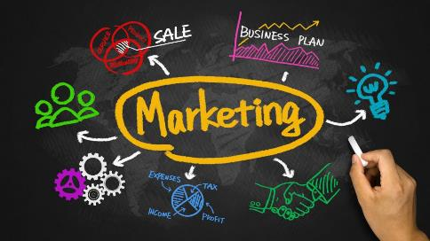
TOPIC 1: AN OVERVIEW OF MARKETING
https://www.manbiz.com/marketing-campaign-strategy-taking-an-omni-channel-approach/

Slide 2
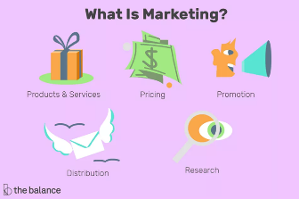
Activity: What is marketing? (individual & group activity)
Write down three words (not those in the picture ☺) that, to your mind, describe marketing, or form part of marketing.
Compare your answers to the answers of your breakaway group members.
Which words were mentioned by more than one of the group members?
https://www.thebalancesmb.com/marketing-in-business-2948349

Slide 3
Definition of marketing
AMERICAN MARKETING ASSOCIATION
“Activities, set of institutions, and processes involved in creating, communicating, delivering, and exchanging offerings that have value for customers, clients, partners, and society at large.”
Value = trade-off/balance between what is “given up” in return to what is being “received”.
https://www.ama.org/AboutAMA/Pages/Definition-of-Marketing.aspx

Slide 4
Definition of marketing
CHARTERED INSTITUTE OF MARKETERS’ DEFINITION
Marketing is the management process responsible for identifying, anticipating and satisfying customer requirements profitably.
https://www.cim.co.uk/media/4772/7ps.pdf

Slide 5
Simplest definition of marketing
Getting the right goods to the right people at the right place at the right time and at the right price, and with the right level of communication, doing so profitably.
“Right” =.

Slide 6
Two sides of the marketing “coin”
Two sides of the marketing “coin”:
Set of activities (4Ps, segmentation, targeting and positioning).
Philosophy/belief/orientation regarding the essence of marketing or the focus of the marketing activities.

Slide 7
First side of the coin: Set of activities (four Ps of the marketing mix)
4 Ps, 4 As & 4Cs
Product - what is being offered to the market (Acceptability – Provides Customer Value)
Price – establishing an exchange (Affordability – Captures value via Cost)
Place – how and where the product reaches the market (Availability – Delivers value via Convenience)
Promotion – informing customer about the product (Awareness – Tells about value via Communication)

Slide 8
Further explanation of the 4Ps
This video will provide you with a further explanation of the 4Ps of marketing.
After watching the video, answer the following questions:
Why is a “product” not just a “thing” (only the physical product)?
What should the “price” do?
What is the purpose of “promotion”?
https://www.youtube.com/watch?v=1g8fq7uUhgM

Slide 9
Activity: 4Ps
Which one of the 4Ps is probably the most important element of the marketing mix from the average customer’s perspective when wanting to buy the following products or services? Why?
Take-away hamburgers, e.g. McDonald’s (Group 1)
Wanting to impress that “special” person with a meal in a restaurant (Group 2)
Bottled water (Group 3)
Computer software (Group 4)
Finding optical services to replace your lost glasses while travelling in a country you have never been to before (Group 5)

Slide 10
Two sides of the marketing “coin”
Second side of the marketing “coin”:
Set of activities and processes used in implementing the philosophy
Philosophy/belief/orientation with an influence on the marketing activities and processes
Production orientation (Group 1)
Product orientation (Group 2)
Sales orientation (Group 3)
Market orientation (Group 4)
Societal marketing orientation (Group 5)

Slide 11
Activity: Orientations
Use the link below and answer the questions.:
For the assigned orientation (previous slide):
Explain the orientation
List its advantages
List its disadvantages
Give an example of an organization that successfully follows this orientation
Which orientation does the company where you are employed, follow?
Marketing Orientation Approaches

Slide 12

Thank you!
https://www.manbiz.com/marketing-campaign-strategy-taking-an-omni-channel-approach/

